Slide 1
Movie-lens analysis
CSp 571 data preparation and analysis
Ranganathan Karpagam Arumuga
Gokul Monday Ramesh
Yudong Wu

Slide 2
PROBLEM DEFINITION
Description:
A large amount of movie related data is available over internet, because of that it is an interesting data mining topic. We have used MovieLens dataset from movielens.org site (20 million observations) to predict and analyze movie patterns.
Problem Statement
To identify patterns in Movielens dataset which will benefit Movie business operation.
Goal
To build a logistic and multiple linear regression model over the movielens dataset.
Forecasting and plotting the obtained model for the upcoming year.

Slide 3
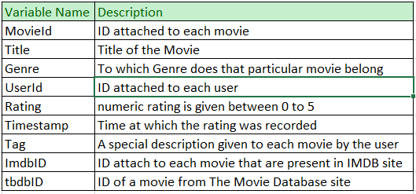
DATA PREPATATION
There are four files, altogether forming movielens dataset. Movies, Rating, Tags and links
Movies: MovieId, Title and Genres
Ratings: UserId, MovieId, Rating and Timestamp
Tags: UserId, MovieId, Tag and
Timestamp
Links: MovieId, Imdbid and tmdId

Slide 4
DATA PREPROCESSING
Filling in Missing Values
Variables such as Year were identified with missing values and stored in separate Data frames.
In Movie dataset, for missing values in Year we have replaced it with 0.
Handling Date and time
For handling Timestamp we used mutate function using the format ‘%y%m%d %H%M’
Separating Movie title and year
Among the data frames, Movie has both Title and year in a single feature. So we separated and inserted them into separate columns and using it for further analysis.
Similarly we split Genres and Tags.

Slide 5
ANALYSIS OF MOVIES DATA
Following are some of the analysis done on data before performing logistic regression:
How many movies were produced per year?
What were the most popular movie genres year by year?
What tags best summarize a movie genre?
The best movies based on users ratings?
The best movie of a decade based on score (weighted average)
What were the best years for a genre (based on users ratings)?

Slide 6
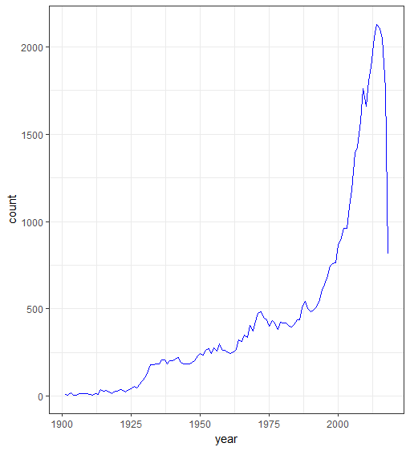
HOW MANY MOVIES WERE PRODUCED PER YEAR?
The graph shows the total number of movies that were produced every year starting from 1900
From the graph we can infer that the movie industry flourished after 2000.
The exponential growth in movie business is somewhat linked to the beginning of information age.
Growing popularity of Internet must have had a positive impact on the demand for movies.

Slide 7
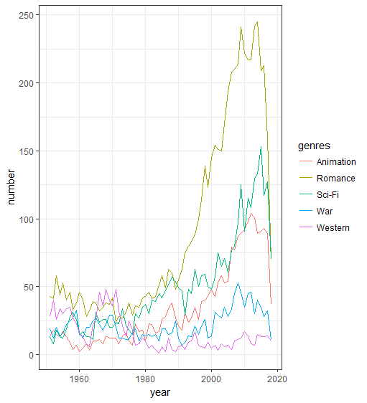
PLOTTING THE MOST POPULAR MOVIE GENRES – COMPARATIVE STUDY
I have plotted Animation, Romance, Sci-Fi, War and Western genre of movies starting from 1950.
Romance/Drama/Comedy have always topped the chart since the start of cinematography.
Significant Observations:
“Western” genre between 1960 and 1980
“War” genre between 1940-1960 and 2008-2012
“Animation” between 1994-2014.

Slide 8
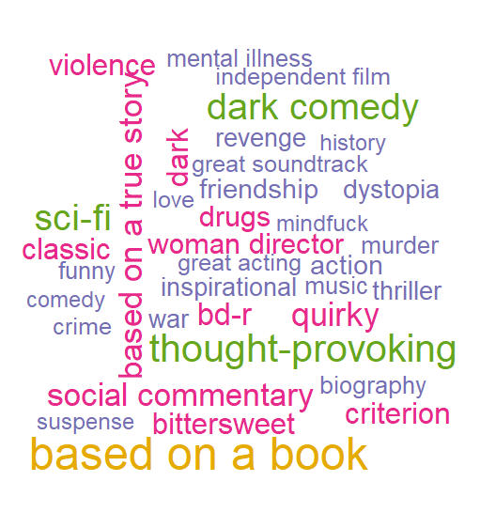
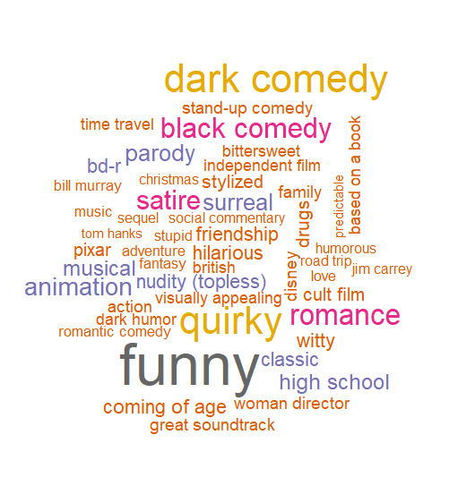
WHAT TAGS BEST SUMMARIZE A MOVIE GENRE?
Tags are nothing but description that are given by the user for a movie.
Here I have created word cloud of two famous genre (i.e.) Drama and Comedy.
The larger words implies that the particular tag was repeatedly used by many users to describe movie.
Drama genre
Comedy genre

Slide 9
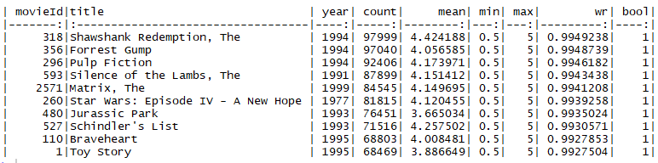
WHAT WERE THE BEST MOVIES (BASED ON USERS RATINGS)?
WR represents Weighted Average = (v/(v+m))*R + (m/(v+m))*C
R = average for the movie (mean) = (Rating)
v = number of votes for the movie = (votes)
m = minimum votes required to be listed in the Top 250
C = the mean vote across the whole report

Slide 10
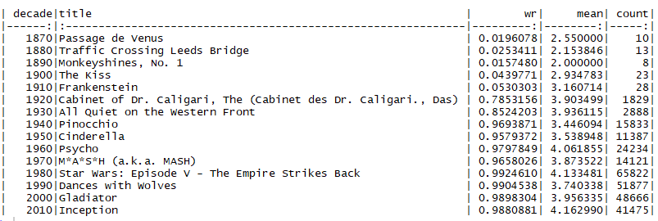
BEST MOVIE OF A DECADE BASED ON WEIGHTED AVERAGE
The above graph shows the best movie of every decade since the beginning of cinematography.
The disadvantage of weighted ratings - low score for old movies. That’s not necessarily caused by movies quality, rather small number of viewers.

Slide 11
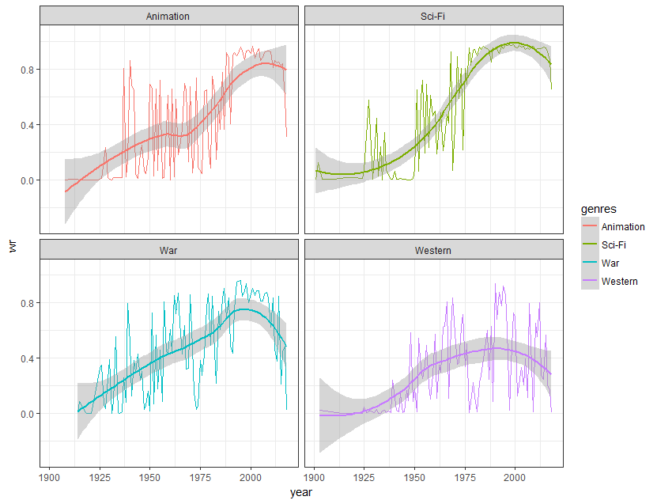
WHAT WERE THE BEST YEARS FOR A GENRE (BASED ON USERS RATINGS)?
It seems that most of the movie genres are actually getting better and better.
Also we can see that there has been many “War” genre movies with average user ratings in the past few years
The surge in Animation and Sci-Fi shows how well our Animation and VFX technology have been flourishing resulting in better user rating.
Movies based on Westernization has been reduced and have got less user rating in the past decade.

Slide 12
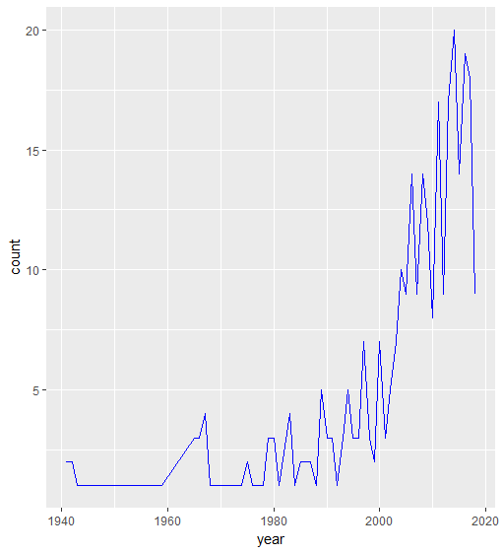
NUMBER OF MOVIES RELEASED PER YEAR FOR “SUPER-HERO” GENRE
From this graph we can see that there very few super hero movies till 2000.
Super man and Spider man in late 1990’s were the major hits for super-hero genre which then bloomed into a very profitable genre in movie industry.

Slide 13
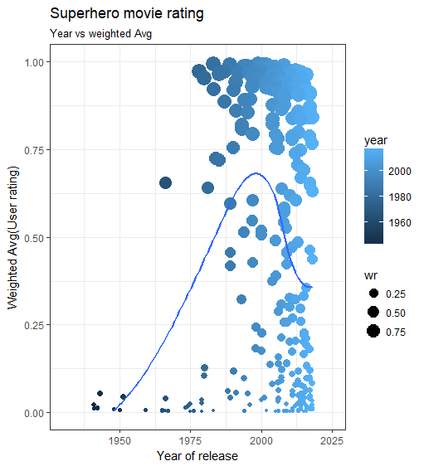
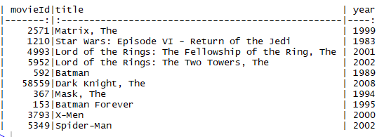
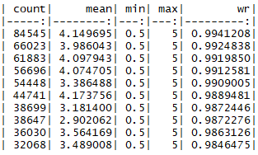
RATINGS FOR SUPER HERO MOVIES OVER THE YEARS
From the graph it is clear that spider man and Batman were the forefathers of superhero genre.

Slide 14
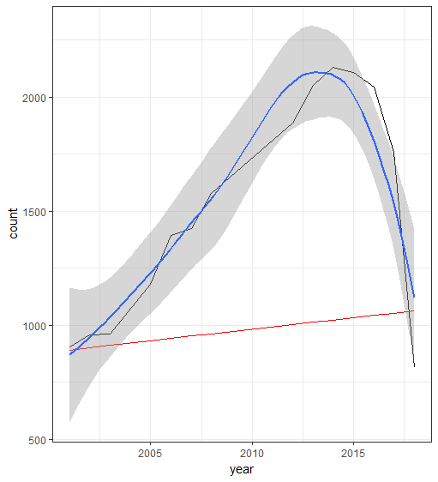
PREDICTING NUMBER OF MOVIES RELEASING NEXT YEAR
To predict the number of movie that will be releasing next year we are using linear model.
Since there are only two features (year, count) Linear model serves the best for prediction.
There has been 816 movies till Sept. 2018 based on our Movielens dataset.

Slide 15
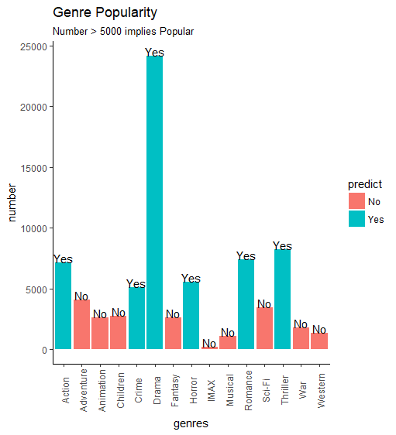
Predicting if a genre is popular?
Here we have use logistic model to predict whether a genre is popular or not.
We have set the popularity condition as Number >5000.
The Yes, No at the top of bar implies the predicted values.

Slide 16
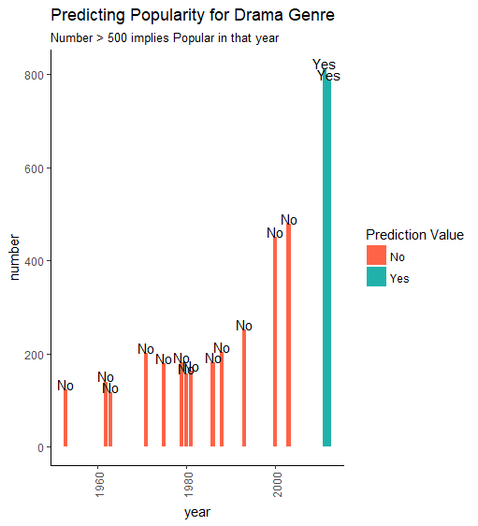
Predicting a specific genre popularity in next year & will it be a pop(Drama) year?
Here we have used Logistic regression model to predict whether a particular Genre will be popular in next year and will it be a “Drama” genre.
The label “yes”, “no” at the top of bar are the predicted values.
From this graph we can see that 2018 will be a year of “Drama” genre.

Slide 17
CONCLUSION AND FUTURE WORK
It is quite interesting to see how the world of cinematography reflected the state of real world.
We are planning to extend this project by involving movie cast through Web scraping by which we can predict some interesting scenarios such as
What cast is the ultimate movie cast
Will the movie budget affect its score

Slide 18
THANK YOU
ANY QUESTION?

